Slide 1
Daemon & non-interactive apps
Notes:
In this unit, you’ll learn how to create apps that obtain tokens without user interaction to either act on behalf of a user or do tasks as the app’s identity.

Slide 2

Overview
Single Page Apps (SPAs)
Web Apps that call APIs
Daemon / Service Apps
OAuth 2.0 client credential flow
Azure AD app registration
MSAL & code configuration
Sign-in & obtain access token
Call APIs

Slide 3
Daemon & non-interactive apps
Notes:
In this first section we’ll look at Daemon & non-interactive apps

Slide 4
Daemon & non-interactive apps
Some applications need to authenticate and obtain an access token to call secured endpoints without any user interaction
Console apps
Services
Web application that needs to access services but not in the context of the current user (Azure KeyVault
These types of apps:
Require application permissions, not delegated permissions
Must have their permissions approved by administrators
Are confidential client applications
Have their own authentication credentials
Notes:
Your application can acquire a token to call a web API on behalf of itself (not on behalf of a user).
This scenario is typically used when an app needs an access token but doesn't want to work under the context of a user+app permissions. Instead, the app needs its own permissions to work independently of a user. These types of permissions are called *application permissions*.
Application permissions are common in service or daemon-related apps. The way this works is the application has its own credentials that are used to authenticate and obtain an access token from a token issuer.
Here are some examples of use cases for daemon apps:
web applications that are used to provision or administer users, or do batch processes in a directory
desktop applications (such as windows services on Windows, or daemons processes on Linux) that do batch jobs, or an operating system service running in the background
web APIs that need to manipulate directories, not specific users
Another common case where non-daemon applications use the client credentials flow is when they need elevated privileges that a user doesn't have. For example, even when apps act on behalf of users, they need to access a web API or a resource with their identity and not the user's identity, such as accessing secrets in Azure KeyVault or an Azure SQL database for a cache.
Applications that acquire a token for their own identities:
Are confidential client applications. These apps, given that they access resources independently of a user, need to prove their identity. They're also rather sensitive apps, which they need to be approved by the Azure Active Directory (Azure AD) tenant admins.
Have registered a secret (application password or certificate) with Azure AD. This secret is passed-in during the call to Azure AD to get a token.

Slide 5
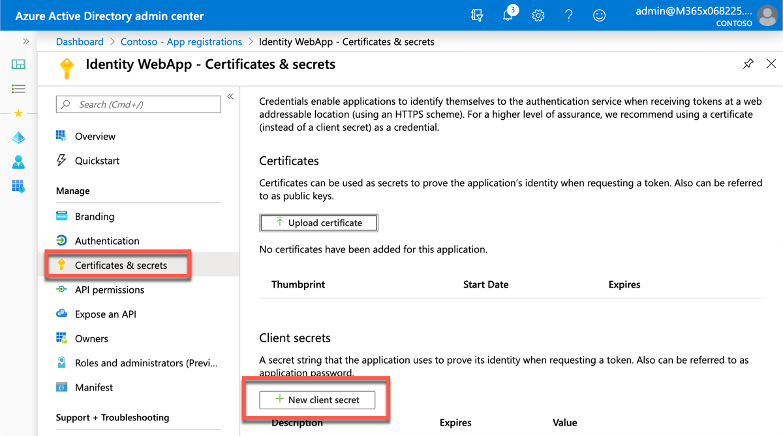
Azure AD app registration
Redirect URI not required for apps that leverage the client credentials flow
Must upload a certificate or create a client secret for the app
Notes:
In order for a service or daemon app to use Microsoft identity to enable users to authenticate and obtain access tokens for use with services such as Microsoft Graph, you must register a new app with Azure AD. This can be done using the Azure AD admin center https://aad.portal.azure.com.
Unlike the previous examples covered in this module, you don't need to specify a redirect URI or sign out URI.
In addition, you don't need to enable the ID token or access token for the implicit grant flow; these don't apply to the client credentials grant flow.
One unique aspect to apps that use the client credentials grant flow is that their permissions must be defined ahead of time, also referred to as static permissions.

Slide 6
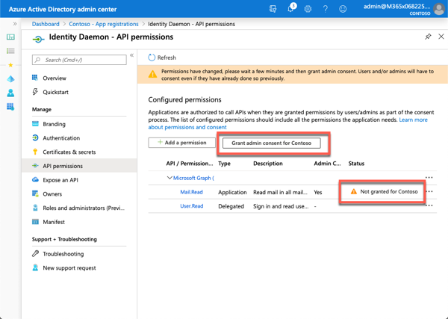
Permissions
Daemon apps can only request application permissions to APIs
Must define all permissions required by the app in Azure AD as application permissions
Permissions must have a tenant admin pre-consent to the app calling the web API
Notes:
Daemon application can only request application permissions to APIs (not delegated permissions). Application permissions are defined on the API Permission page for the application registration.
Daemon applications require have a tenant admin pre-consent to the application calling the web API. This consent is provided in the same API Permission page.

Slide 7
MSAL .NET Configuration
MSAL configuration is similar to a web app that implements the auth code flow
Depending on the app, create a confidential client using a client secret or certificate
string authority = $"https://login.microsoftonline.com/{config["tenantId"]}/v2.0";
var cca = ConfidentialClientApplicationBuilder.Create(clientId)
.WithAuthority(authority).WithClientSecret(clientSecret).Build();
// or
X509Certificate2 certificate = ReadCertificate
var cca = ConfidentialClientApplicationBuilder.Create(clientId)
.WithAuthority(authority).WithCertificate(certificate).Build();
Notes:
The configuration of an app that leverages the client credentials flow is similar to a web app or console app. First create an instance of the confidential client using the MSAL library:

Slide 8
Acquiring an access token
No sign-in required with the client credentials flow
App simply requests an access token by submitting the client ID and secret / certificate
Unlike other OAuth 2.0 flows, don’t include a list of required permissions (scopes) to include in the generated access token
Instead, request a single scope /.default on the end of the app ID for the Daemon
[daemon App ID]/.default
All statically defined & pre-consented scopes will be returned in the token response
Notes:
Note the scopes specified when requesting an access token. In other scenarios, the code specified the exact permission (also known as scopes) the application needed.
The scope to request for a client credential flow is the app ID followed by `/.default`. This tells Azure AD to use the application level permissions declared statically during the application registration.

Slide 9
Calling APIs – Microsoft Graph
private static GraphServiceClient GetAuthenticatedGraphClient(IConfigurationRoot config)
{
var authenticationProvider = CreateAuthorizationProvider(config);
return new GraphServiceClient(authenticationProvider);
}
var client = GetAuthenticatedGraphClient(config);
var requestUserEmail = client.Users[config["targetUserId"]].Messages.Request();
var results = requestUserEmail.GetAsync().Result;
Notes:
Finally, you can use the configured confidential client to call a secured endpoint, such as Microsoft Graph. When using the Microsoft Graph .NET SDK, first create an instance of the MSAL authentication provider.
Next, use the MSAL authentication provider in creating a new instance of the `GraphServiceClient` from the Microsoft Graph .NET SDK.
Finally, use the `GraphServiceClient` to submit requests to Microsoft Graph.

Slide 10
Demo

Slide 11
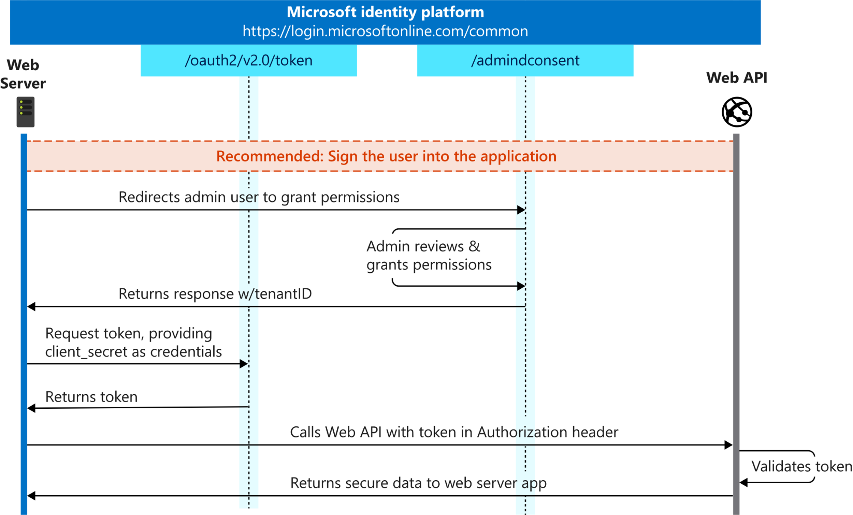
OAuth 2.0 client credentials flow
Notes:
Unlike the scenario covered in the previous unit, the app doesn't need to sign-in to obtain an authorization code. During the Azure AD application registration process, you create an SSL certificate public/private key pair.
The public certificate is registered with our Azure AD app. Within the service or daemon app, the private certificate is used to sign a JWT that is sent to the token endpoint.
Administrators also can use a client secret instead of a certificate, but this is not recommended for production.

Slide 12
Thank you.

